Slide 1
Forensic Tool for Detecting Deepfake & Synthetic Media
Presentation – Progress Update
2025

Slide 2
Current Progress
• Prototype demo developed
• Workflow: Upload → Processing → Results → Metadata → Report
• Offline-ready design under consideration

Slide 3
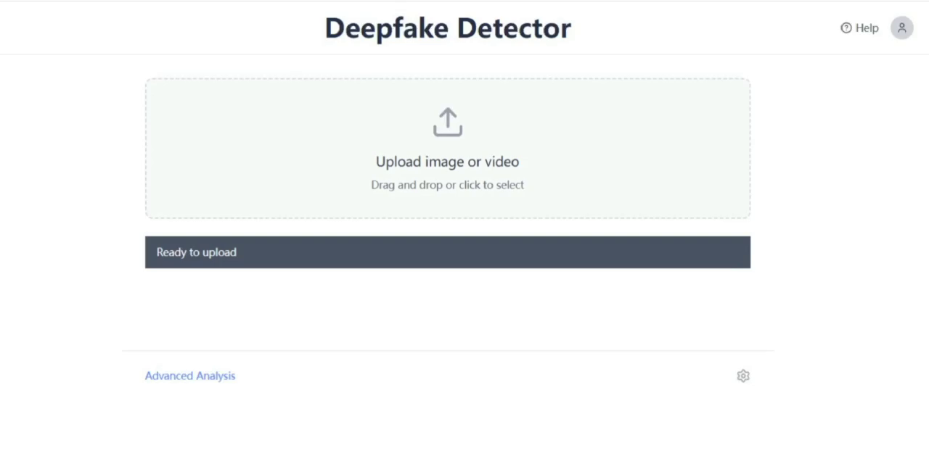
Demo Video
Insert Demo Video Here
(b25c4d143b5eb7bf7a943635fb6cd265.mp4)

Slide 4
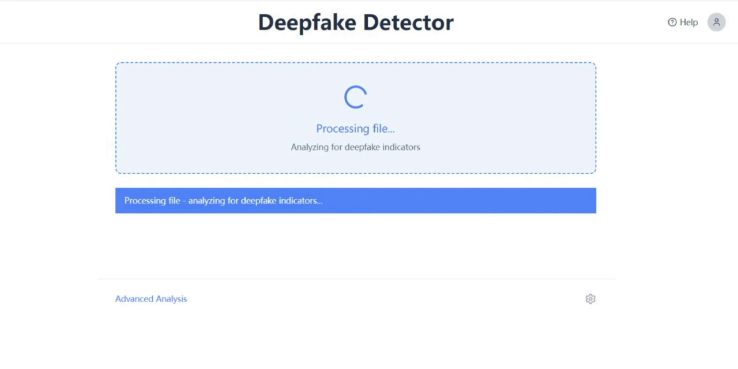
Demo Step 1: Upload

Slide 5
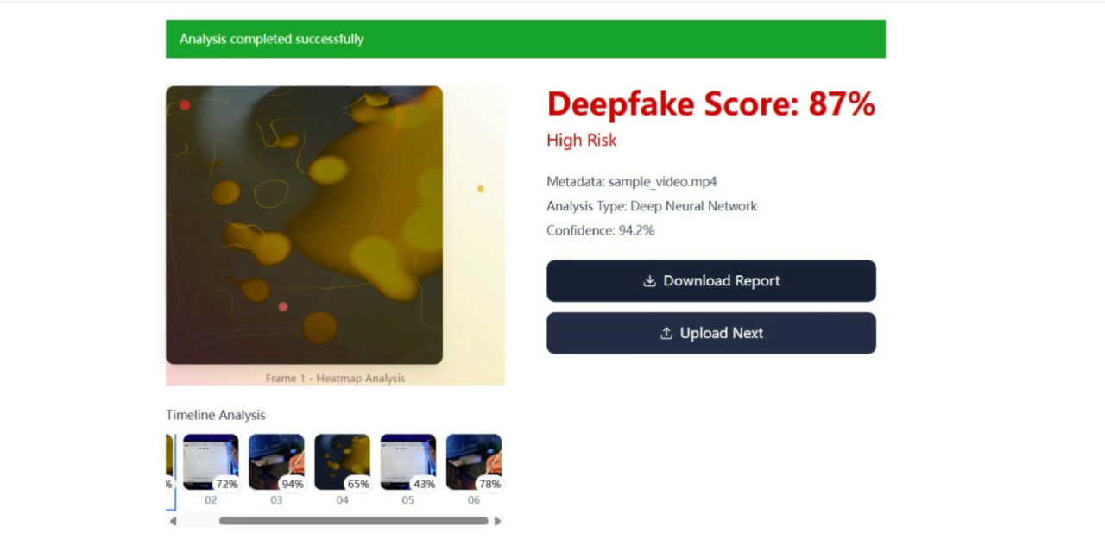
Demo Step 2: Results

Slide 6
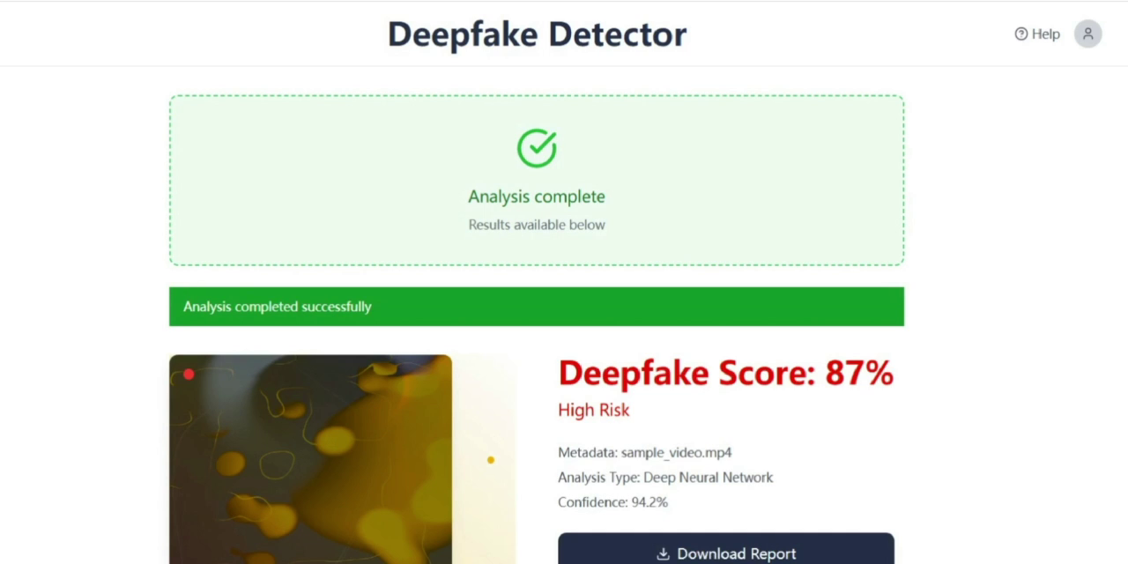
Demo Step 3: Metadata & Report

Slide 7
Why Web Interface?
• Cross-platform: works on Mac, Windows, iOS, and Android
• Lightweight: no installation required
• Flexible: supports both images & videos
• Easy to update frontend without reinstalling

Slide 8
How to Run Web App Offline
• Web frontend + local backend architecture
• Deployment options:
- Localhost (single machine, fully offline)
- Internal server (multi-user within forensic lab)
• All models & data stored locally
• Complies with forensic industry restrictions

Slide 9
Report Output
• Image reports: suspicious regions with metadata
• Video reports: keyframes with timestamps
• Export formats: PDF / JSON

Slide 10
Next Steps
• Sprint 1: Backend integration → real model outputs
• Sprint 2: Improve video analysis & visualization
• Sprint 3: Finalize report generation & client feedback integration

Slide 11
Questions for Client
• Do you expect investigators to use this tool anytime and anywhere,
or only within secure offline environments?
• Would you like reports to remain only on the local machine, or have an option to share them securely with colleagues?

